Slide 1

Bridging the Gap Between Programming and Energy
Bytes to Watts
A Practical Guide for Energy Programming
Chrispine Tinega
Notes:
Why Are We Here?
To explore how programming drives innovation in energy.
To inspire you to apply coding in energy systems.

Slide 2


A study analysing approximately 200 introductory (CS1) and software engineering assignments found that only 41% lacked context. In contrast, 16% of software engineering projects lacked practical context.
2
Notes:
This absence of contextual learning can lead to decreased motivation and higher dropout rates among programming students.
Factors such as low learning motivation, lack of interest in the subject, and inadequate course design have been linked to increased dropout rates in computer programming courses.

Slide 3


Chrispine Tinega
Embedded Systems Engineer specializing in IoT for renewable energy systems
Passionate about using technology to solve real-world energy challenges
Mentor and speaker with experience in smart mini-grids and energy management systems
https://chrispinetinega.com
3
Notes:
Embedded Systems QA Engineer specializing in IoT for renewable energy systems.
Passionate about using programming to solve real-world energy challenges.
Mentor and speaker with experience in smart mini-grids and energy management systems.

Slide 4

The Gap: Why Context Matters
Learning in Isolation:
Students learn programming as an abstract skill, detached from real-world applications.
Energy Systems as a Mystery:
Many see energy systems as technical and inaccessible without specialised knowledge.
The Missing Link:
No direct examples connect coding concepts (e.g., loops, algorithms) to energy applications.
The Result:
Missed opportunities to contribute to energy-sector advancements.
4
Notes:
Have you ever felt disconnected from what you’re learning?
traditional programming education often lacks integration with practical applications, particularly in fields like energy.
without this context, students might see programming as abstract or irrelevant to their future careers in energy.
'eureka' moment that connected the dots between coding and practical engineering: PROJECT
providing context not only makes programming more engaging but also motivates students by showing them a clear path from learning to application.
Career Preparation:
Emphasise how this contextual learning prepares students better for careers in the energy sector, where programming skills are increasingly in demand for roles in smart grid technology, renewable energy systems, and IoT for energy management.

Slide 5

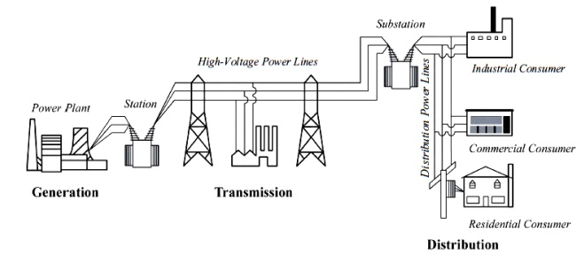
Energy Systems Overview
From Power Generation to Optimization
Core Components:
Generation: solar, wind, hydro, and thermal (renewable and non-renewable sources).
Distribution: power grid, substations, transmission lines.
Consumption: homes, industries, and businesses.
BiNus Library | bab2BMC20150034
5
Notes:
Energy systems encompass the technologies and processes used to produce, distribute, and consume energy.
They include renewable sources like solar and wind, as well as traditional fossil fuels. Understanding these systems is essential for developing effective software solutions that optimize their performance.

Slide 6
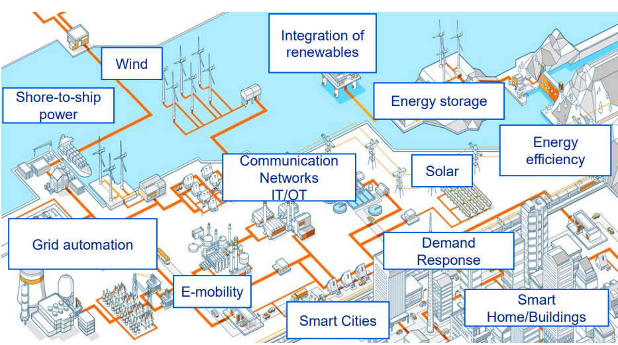
Energy Systems Overview
Key Challenges:
Grid Stability and Resilience
System Efficiency
Data Integration and Interoperability
Intermittent Sorces Integration
Real-Time Monitoring and Analytics
Cybersecurity
Fault Detection and Maintenance
Decentralized Energy Systems
Regulatory Compliance
Gunnar Björkman, ABB Mannheim Smart Grids and Security Chalmers
6
Notes:
Grid Stability and Resilience
Challenge: Managing frequency and voltage fluctuations caused by intermittent renewable energy sources like solar and wind.
Programming Need: Development of real-time monitoring and control algorithms to stabilise grid parameters.
System efficiency
2. Data Integration and Interoperability
Challenge: Energy systems use diverse devices and protocols that must seamlessly communicate.
Programming Need: Designing middleware and APIs for protocol conversion and cross-platform integration.
6. Renewable Energy Integration
Challenge: Coordinating the integration of solar, wind, and hydropower into existing grids.
Programming Need: Developing EMS (Energy Management Systems) for dynamic load balancing and generation optimisation.
8. Real-Time Monitoring and Analytics
Challenge: Collecting and processing vast amounts of data from energy assets.
Programming Need: Building real-time data pipelines and visualisation dashboards.
3. Cybersecurity
Challenge: Protecting energy systems from cyber-attacks, which can disrupt critical infrastructure.
Programming Need: Implementing encryption, intrusion detection, and secure communication protocols.
5. Energy Forecasting
Challenge: accurately predicting energy demand and renewable generation based on weather and consumption patterns.
Programming Need: Employing machine learning models and predictive analytics.
10. Fault Detection and Maintenance
Challenge: Early identification of faults in grid components and renewable energy assets.
Programming Need: Using AI/ML for anomaly detection and predictive maintenance.
11. Decentralized Energy Systems
Challenge: Managing peer-to-peer energy trading and microgrid operations.
Programming Need: Implementing blockchain for secure, decentralized transaction management.
12. Regulatory Compliance
Challenge: Ensuring systems meet energy standards and emission regulations.
Programming Need: Automating compliance reporting and integrating regulatory updates.

Slide 7



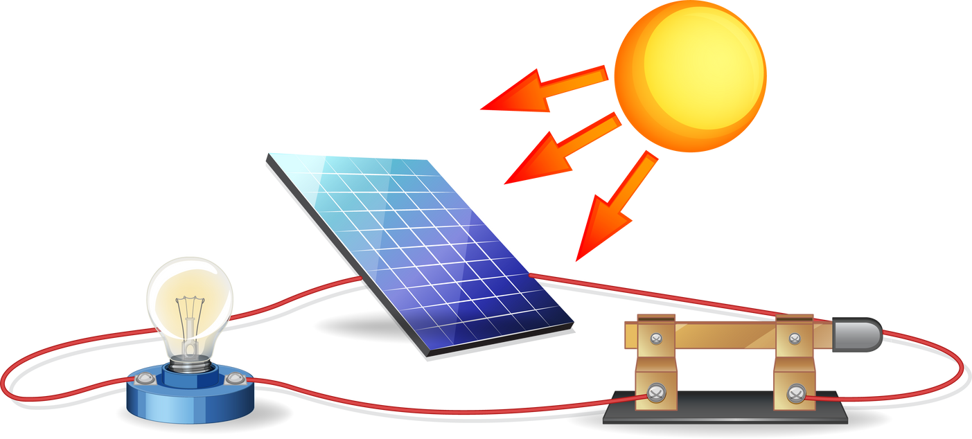

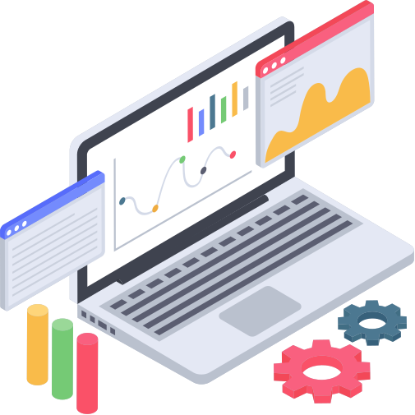
The Role of Programming in Energy
Data Collection and Monitoring:
IoT devices and sensors gather real-time data.
Automation and Control:
Programming enables automation of repetitive tasks.
Optimisation:
Algorithms improve efficiency in energy distribution and usage.
Analysis and Prediction:
Big data and AI predict demand patterns and identify inefficiencies.
User Interfaces and Management:
Applications for visualising energy usage and system health.
From Bytes to Watts
Every line of code has the potential to power homes, optimise grids, and transform energy use.
7
Notes:
Explain how programming is integral to energy systems:
IoT (Internet of Things): Discuss how IoT devices in the energy sector, like smart meters and sensors, rely on programming to collect real-time data on energy consumption, generation, and distribution. This data can then be processed to provide insights or trigger actions. Mention how protocols like MQTT facilitate this communication, ensuring data is efficiently shared across the network.
Automation: Explain that programming enables automation in energy management systems. For instance, smart thermostats adjust heating or cooling based on algorithms that predict user comfort while minimizing energy use. Highlight how automation can lead to energy savings by optimizing operations like turning off lights or adjusting HVAC systems when not needed.
Optimization: Dive into how programming is used for optimizing energy systems. This includes algorithms for load balancing in power grids, demand response programs where energy consumption is adjusted in real-time based on supply, and predictive maintenance in energy infrastructures. Emphasize how optimization leads to energy efficiency, reducing waste and costs.

Slide 8

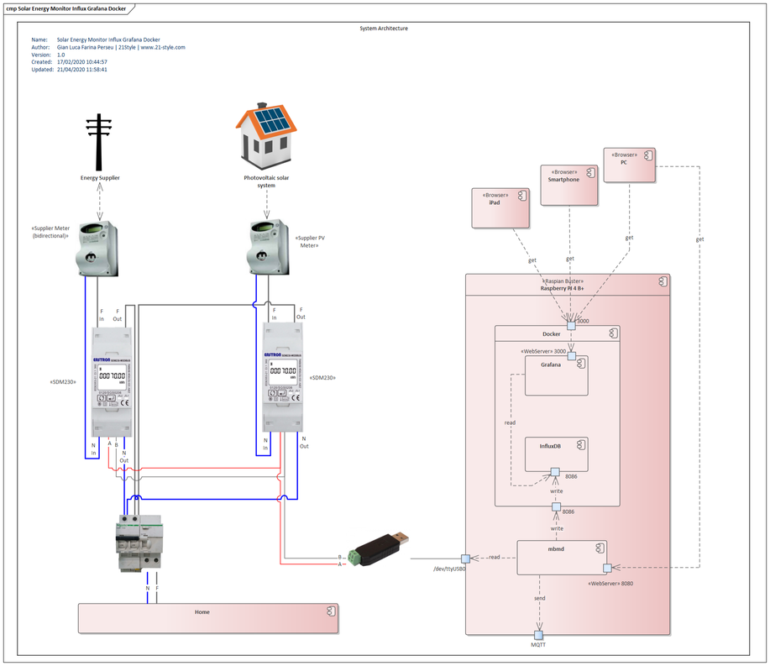










Data Collection and Monitoring
Gathering real-time data from energy systems to understand performance and make informed decisions.
Tools and technologies:
Protocols:
Modbus (RTU/TCP), MQTT, CoAP, KNX, Zigbee, LoRaWAN, LightweightM2M, CAN, IEC 61850, OPC UA, BACnet, RESTful APIs, SNMP, AMQP, DDS, M-Bus, Profibus, Ethernet/IP.
Platforms:
Commercial Platforms: Siemens MindSphere, Schneider Electric EcoStruxure, Honeywell Forge, ABB Ability
IoT and Cloud-Based Platforms: AWS IoT Core, Microsoft Azure IoT Central, Google Cloud IoT Core, ThingsBoard
https://github.com/glfp/SolarEnergyMonitorInfluxGrafanaDocker
Notes:
Industrial Communication Protocols
Modbus
Variants: Modbus RTU (serial) and Modbus TCP (Ethernet).
Used for: Communication between energy meters, inverters, and controllers.
KNX
Used for: Building automation, including energy management and monitoring.
CAN (Controller Area Network)
Variants: CANopen, J1939.
Used for: Monitoring and control of devices in automotive and industrial energy systems.
BACnet (Building Automation and Control Network)
Used for: HVAC, lighting, and energy management in buildings.
Key Feature: Standardised for building automation systems.
M-Bus (Meter-Bus)
Used for: Metering applications like electricity, gas, and water meters.
Key Feature: Optimised for battery-powered meters.
IoT and Cloud Communication Protocols
MQTT (Message Queuing Telemetry Transport)
Used for: cloud-based energy monitoring and IoT platforms.
Key Feature: Lightweight and efficient for low-bandwidth environments.
CoAP (Constrained Application Protocol)
Used for: Energy monitoring in constrained devices and IoT systems.
Key Feature: RESTful protocol optimized for small devices.
AMQP (Advanced Message Queuing Protocol)
Used for: High-performance messaging in cloud applications.
Key Feature: Robust messaging for energy data transmission.
DDS (Data Distribution Service)
Used for: Real-time energy system monitoring and control.
Key Feature: High-speed and reliable communication.
LwM2M (Lightweight Machine-to-Machine)
Used for: IoT device management and energy monitoring.
Key Feature: Efficient device management for constrained devices.
Energy-Specific Protocols
IEC 61850
Used for: Substation automation and energy system monitoring.
Key Feature: Standardized protocol for electrical utilities.
DNP3 (Distributed Network Protocol)
Used for: Energy monitoring in SCADA systems.
Key Feature: Designed for reliable communication over long distances.
OPC UA (Open Platform Communications Unified Architecture)
Used for: Interoperability in industrial and energy systems.
Key Feature: Platform-independent and secure.
Wireless Protocols
LoRaWAN
Used for: Long-range energy monitoring in remote locations.
Key Feature: Low power and long-range communication.
Zigbee
Used for: Smart energy devices and home automation.
Key Feature: Mesh networking for scalability.
Sigfox
Used for: Remote energy monitoring and IoT applications.
Key Feature: Ultra-narrowband communication.
Wi-Fi
Used for: Local energy monitoring systems.
Key Feature: High-speed communication.
Bluetooth Low Energy (BLE)
Used for: Short-range monitoring and configuration of energy devices.
Key Feature: Energy-efficient communication.
Emerging Protocols
IEEE 2030.5 (Smart Energy Profile 2.0)
Used for: Communication between energy management systems and distributed energy resources (DERs).
Key Feature: Designed for smart grid applications.
OpenADR (Open Automated Demand Response)
Used for: Demand response and energy load control.
Key Feature: Facilitates real-time energy demand management.
RESTful APIs
Used for: Integrating modern cloud-based energy monitoring systems.
Key Feature: Easy integration with web-based platforms.

Slide 9

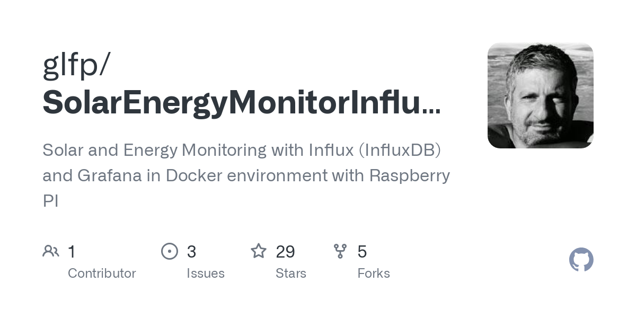

GitHub - glfp/SolarEnergyMonitorInfluxGrafanaDocker: Solar and Energy Monitoring with Influx (InfluxDB) and Grafana in Docker environment with Raspberry PI
https://github.com/glfp/SolarEnergyMonitorInfluxGrafanaDocker
9

Slide 10
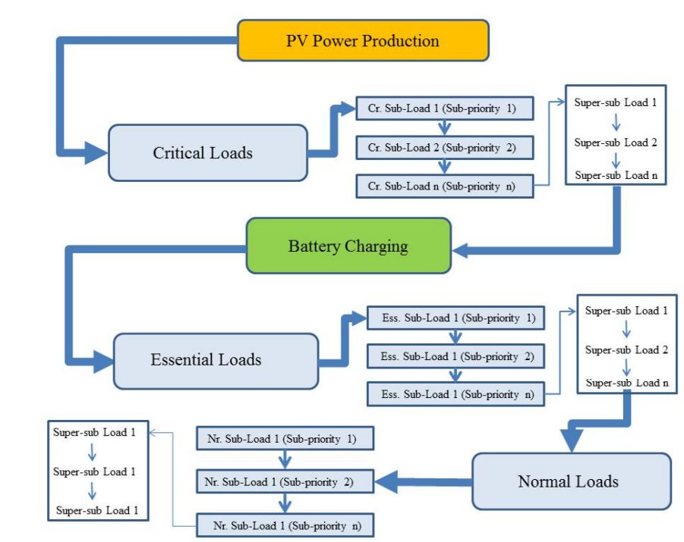
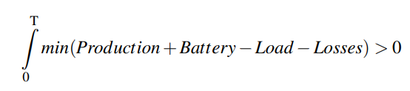
Automation and Control
Automating processes and controls in energy systems ensures efficiency, reduces manual intervention, and improves reliability.
Tools and technologies:
EMS Software: Energy management systems Home Assistant, and proprietary solutions.
Platforms:
Open-Source Platforms: OpenEMS, OpenMUC
https://doi.org/10.1109/EPE.2014.6910767
Notes:
over a time period [0 T], the total power supply
at any particular point in time must always be greater than the load demand (and
losses)
balancing occurs under some constraints
such as efficiency, costs, reliability, protection, and communication infrastructure.
Platforms
OpenEMS
Description: A modular and scalable Energy Management System (EMS) for energy monitoring and control.
Key Features: Open-source, supports integration with various devices using protocols like Modbus.
Use Cases: Monitoring renewable energy sources, battery systems, and load management.
OpenMUC
Description: A framework for energy data acquisition and management.
Key Features: Supports Modbus, MQTT, and IEC 61850 protocols.
Use Cases: Data collection and system monitoring for smart grids.

Slide 11
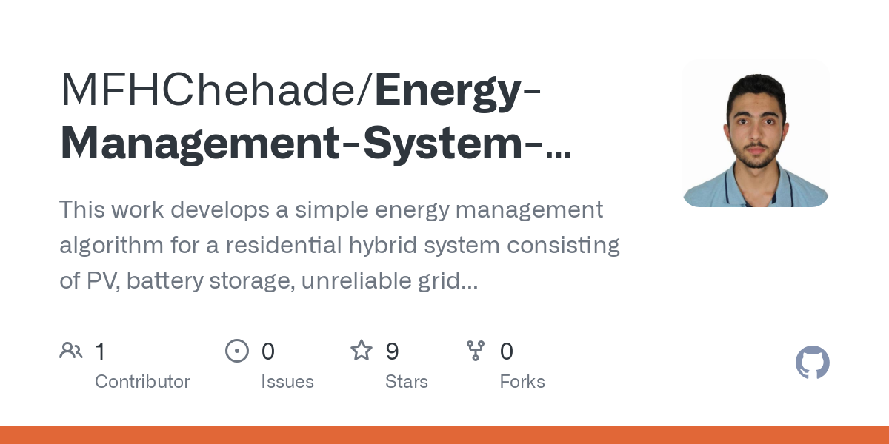
GitHub - MFHChehade/Energy-Management-System-for-Hybrid-Microgrid: This work develops a simple energy management algorithm for a residential hybrid system consisting of PV, battery storage, unreliable grid and a diesel generator.
https://github.com/MFHChehade/Energy-Management-System-for-Hybrid-Microgrid
11

Slide 12
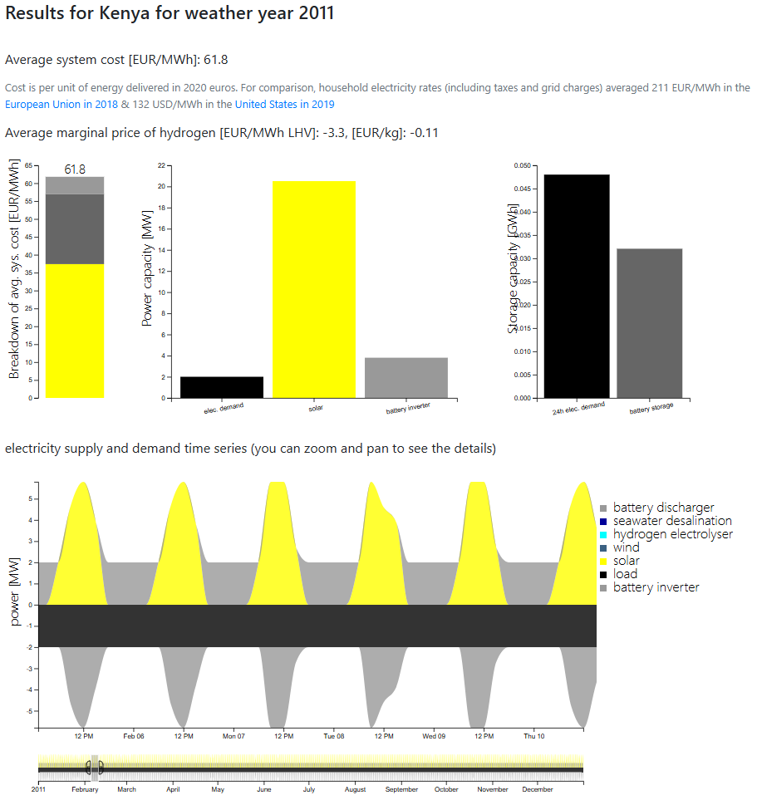


Optimisation in Energy Systems
Process of finding the best possible solution to a problem by minimising or maximising a given objective function, subject to certain constraints.
Best configuration or operational strategy for energy systems to maximise efficiency, minimise costs, or achieve sustainability goals.
Tools and Technologies:
Optimization Libraries: PyPSA, Pandas, SciPy, PuLP, Gurobi, MATLAB, SCILAB
Algorithms: linear programming, genetic algorithms, and ML models for predictive optimisation.
Software Platforms: HOMER Energy, Pyomo, and GridLAB-D for advanced energy modelling
https://upcommons.upc.edu/handle/2117/421318
https://model.energy/
Notes:
PyPSA (Python for Power System Analysis)
Description: A free Python library for analyzing and optimizing power systems.
Key Features: Open-source, suitable for grid modeling, optimization, and scenario analysis.
Use Cases: Mini-grid and hybrid system modeling, renewable energy integration.
Gurobi is a
mathematical optimisation software that offers powerful algorithms for solving various optimisation problems, including linear programming, quadratic programming, and mixed-integer programming. It provides a Python API called GurobiPy
Equation 1: Basic Optimisation Problem
𝑚𝑖𝑛.𝑓(𝑥),𝑥 ∈Ω
Where 𝑓(𝑥) is the objective function, 𝑥 is the decision variable and Ω represents the set of constraints that limit the solution space. (Lucas Downey, 2022; Stephen J. Wright, 2024)

Slide 13
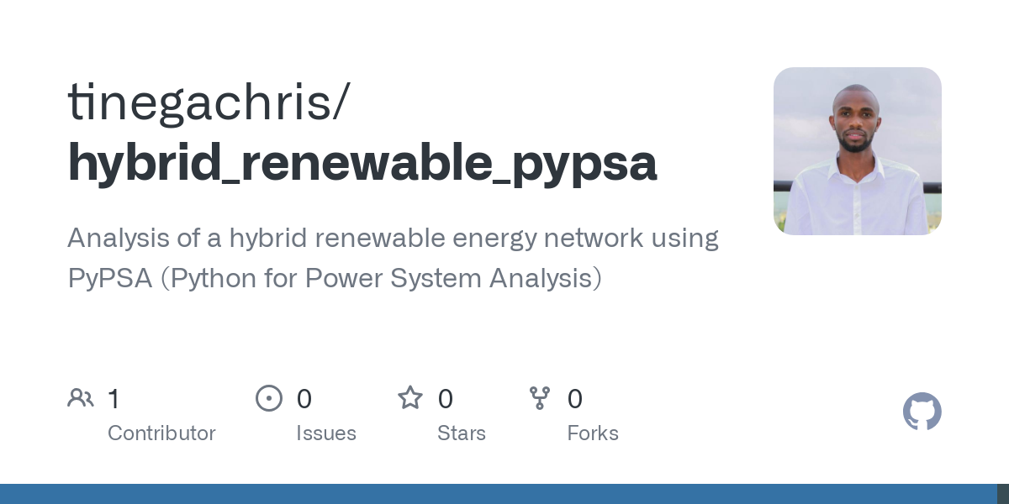
GitHub - tinegachris/hybrid_renewable_pypsa: Analysis of a hybrid renewable energy network using PyPSA (Python for Power System Analysis)
https://github.com/tinegachris/hybrid_renewable_pypsa
13

Slide 14
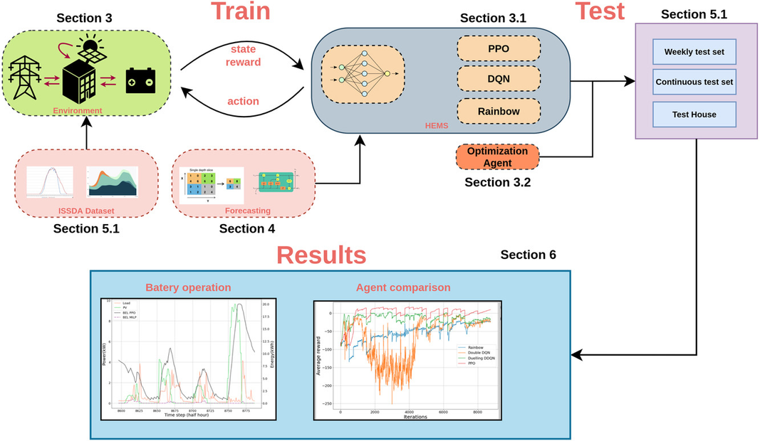
Analysis and Prediction in Energy Systems
Analysis: Interprets energy data to uncover actionable patterns, like peak usage times or system inefficiencies.
Prediction: Uses historical and real-time data to forecast future energy demands and optimise resource allocation.
Tools and Technologies:
Python Libraries for Data Analysis:
Pandas, NumPy, SciPy, Matplotlib, Seaborn, Plotly.
Machine Learning & AI Frameworks:
Regression models, time-series analysis (ARIMA, Prophet).
TensorFlow, PyTorch, and Scikit-learn for building predictive algorithms.
Cloud Computing Platforms for Scalability:
AWS: Amazon SageMaker, AWS Lambda.
Google Cloud: BigQuery, Vertex AI, AutoML.
Azure: Azure ML, Azure Functions, Synapse Analytics.
https://doi.org/10.1016/j.egyai.2024.100347
Notes:
Definition and Importance:
These are critical for proactive decision-making and system reliability.
Real-World Applications:
Demand Forecasting:
Predicting energy consumption trends to avoid over/underproduction.
Renewable Generation Forecasting:
Estimating solar and wind power output based on weather data.
Anomaly Detection:
Identifying irregularities in energy usage to detect faults or inefficiencies.
Challenges in Prediction:
Inconsistent or incomplete data.
High variability in renewable energy sources like solar and wind.
Balancing model complexity with real-time operational constraints.

Slide 15
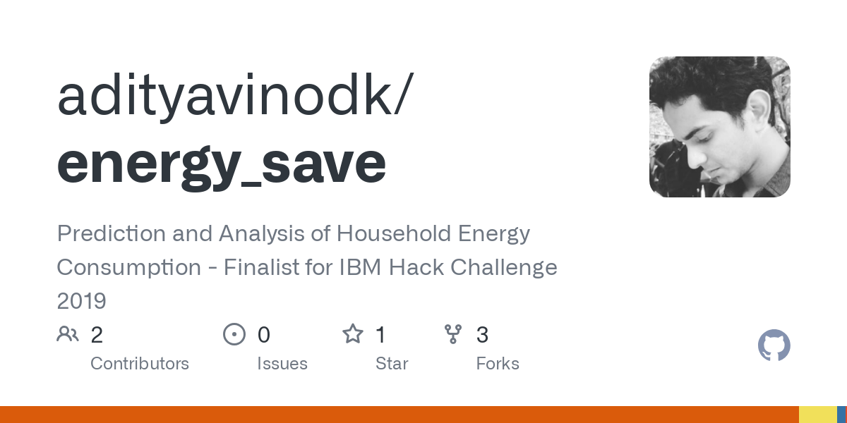
GitHub - adityavinodk/energy_save: Prediction and Analysis of Household Energy Consumption - Finalist for IBM Hack Challenge 2019
https://github.com/adityavinodk/energy_save
15

Slide 16
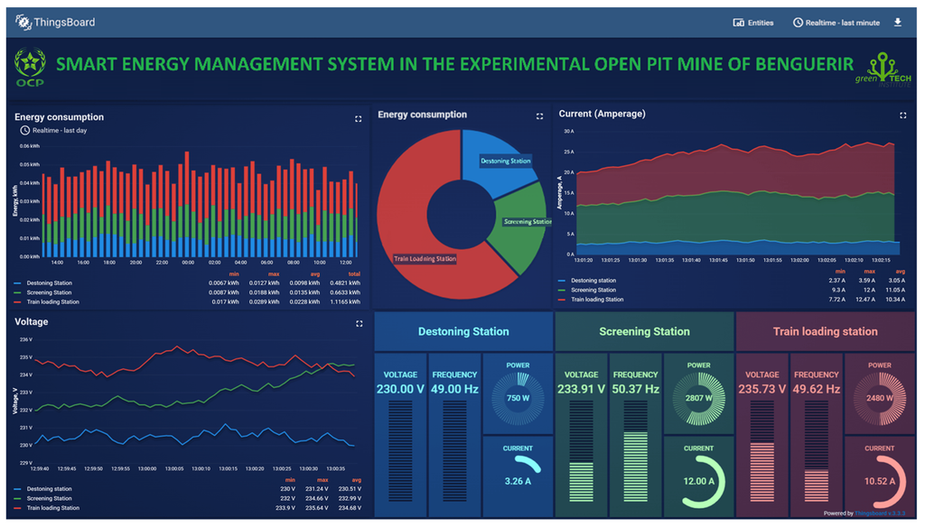
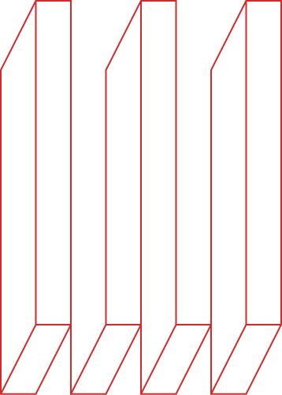
User Interfaces and Management
Facilitates real-time monitoring, control, and decision-making while ensuring accessibility for non-technical stakeholders.
Tools and Technologies:
Real-Time Visualisation:
Grafana, Tableau, or custom-built interfaces using frameworks like React, Angular, or Vue.js
Alerts and Notifications:
Twilio for communication or custom logic via APIs.
Control Capabilities:
Remote control of energy system devices and load management
Integration APIs:
RESTful APIs or GraphQL allow communication between the interface and energy systems.
Database Options:
MySQL, and PostgreSQL for structured data.
MongoDB or Firebase for dynamic, scalable applications.
https://doi.org/10.3390/asi5010018
Notes:
Industrial Communication Protocols
Modbus
Variants: Modbus RTU (serial) and Modbus TCP (Ethernet).
Used for: Communication between energy meters, inverters, and controllers.
KNX
Used for: Building automation, including energy management and monitoring.
Key Feature: Interoperability in smart buildings.
CAN (Controller Area Network)
Variants: CANopen, J1939.
Used for: Monitoring and control of devices in automotive and industrial energy systems.
Key Feature: Reliable and robust communication in harsh environments.
BACnet (Building Automation and Control Network)
Used for: HVAC, lighting, and energy management in buildings.
Key Feature: Standardized for building automation systems.
M-Bus (Meter-Bus)
Used for: Metering applications like electricity, gas, and water meters.
Key Feature: Optimized for battery-powered meters.
IoT and Cloud Communication Protocols
MQTT (Message Queuing Telemetry Transport)
Used for: Cloud-based energy monitoring and IoT platforms.
Key Feature: Lightweight and efficient for low-bandwidth environments.
CoAP (Constrained Application Protocol)
Used for: Energy monitoring in constrained devices and IoT systems.
Key Feature: RESTful protocol optimized for small devices.
AMQP (Advanced Message Queuing Protocol)
Used for: High-performance messaging in cloud applications.
Key Feature: Robust messaging for energy data transmission.
DDS (Data Distribution Service)
Used for: Real-time energy system monitoring and control.
Key Feature: High-speed and reliable communication.
LwM2M (Lightweight Machine-to-Machine)
Used for: IoT device management and energy monitoring.
Key Feature: Efficient device management for constrained devices.
Energy-Specific Protocols
IEC 61850
Used for: Substation automation and energy system monitoring.
Key Feature: Standardized protocol for electrical utilities.
DNP3 (Distributed Network Protocol)
Used for: Energy monitoring in SCADA systems.
Key Feature: Designed for reliable communication over long distances.
OPC UA (Open Platform Communications Unified Architecture)
Used for: Interoperability in industrial and energy systems.
Key Feature: Platform-independent and secure.
Wireless Protocols
LoRaWAN
Used for: Long-range energy monitoring in remote locations.
Key Feature: Low power and long-range communication.
Zigbee
Used for: Smart energy devices and home automation.
Key Feature: Mesh networking for scalability.
Sigfox
Used for: Remote energy monitoring and IoT applications.
Key Feature: Ultra-narrowband communication.
Wi-Fi
Used for: Local energy monitoring systems.
Key Feature: High-speed communication.
Bluetooth Low Energy (BLE)
Used for: Short-range monitoring and configuration of energy devices.
Key Feature: Energy-efficient communication.
Emerging Protocols
IEEE 2030.5 (Smart Energy Profile 2.0)
Used for: Communication between energy management systems and distributed energy resources (DERs).
Key Feature: Designed for smart grid applications.
OpenADR (Open Automated Demand Response)
Used for: Demand response and energy load control.
Key Feature: Facilitates real-time energy demand management.
RESTful APIs
Used for: Integrating modern cloud-based energy monitoring systems.
Key Feature: Easy integration with web-based platforms.

Slide 17

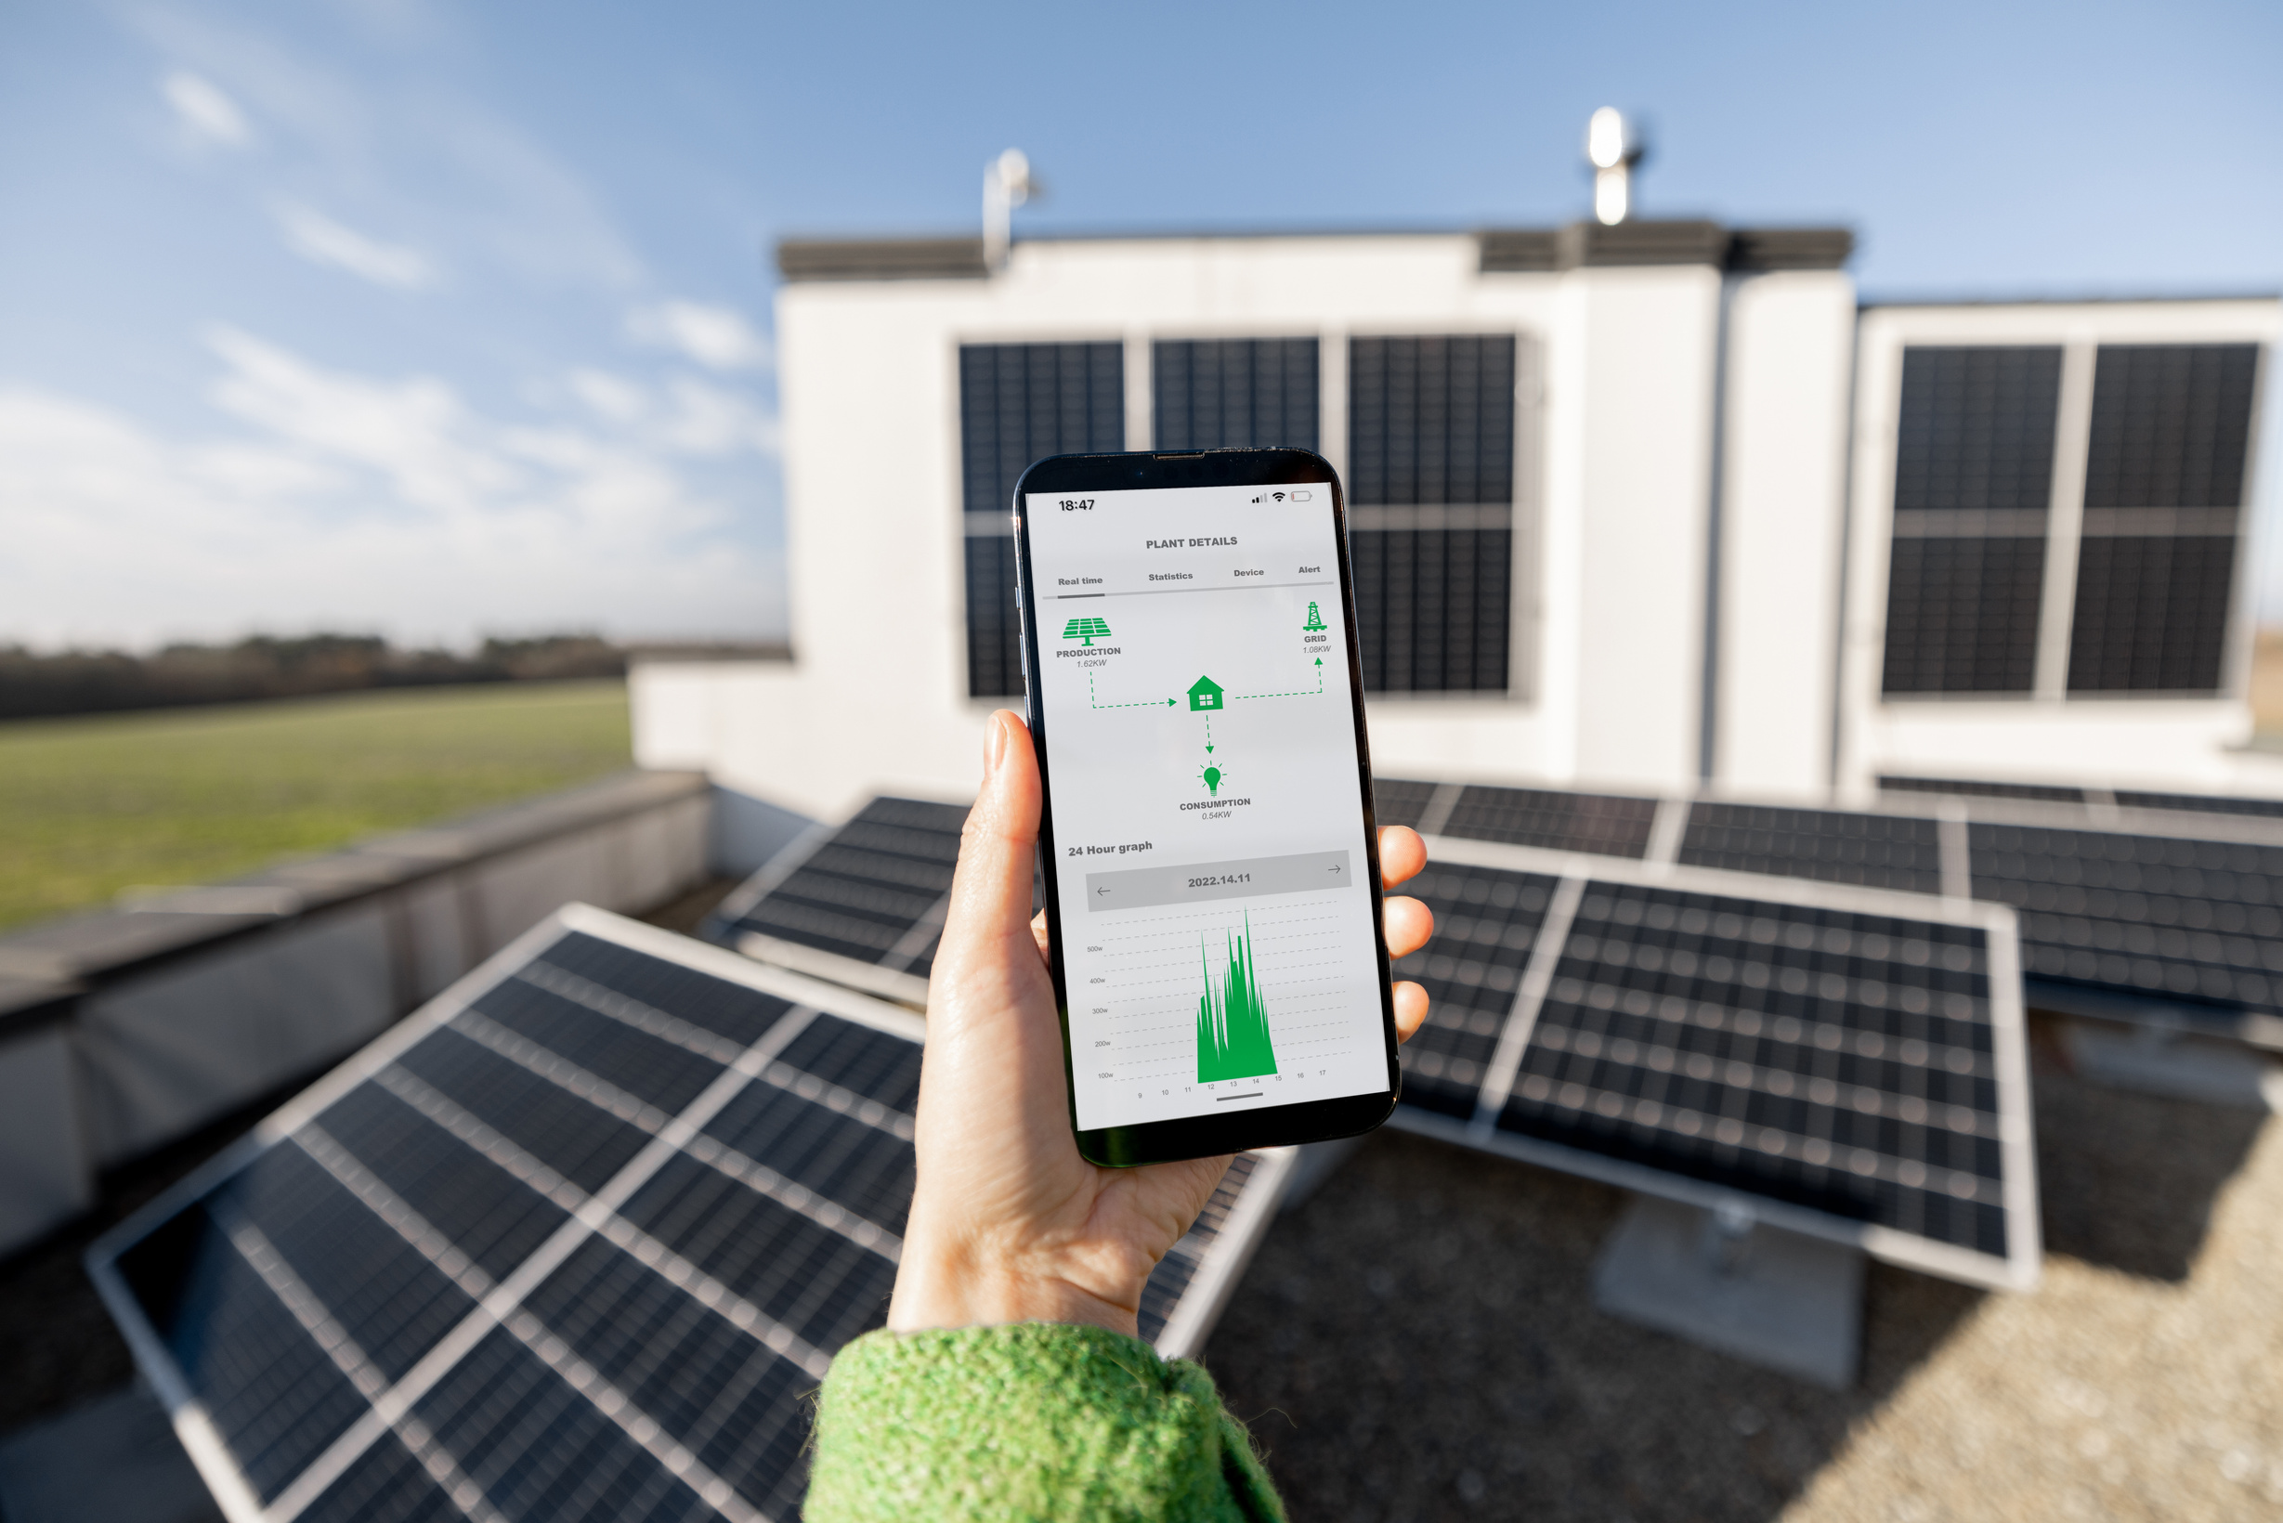
Practical Demo
Simple Python Script for Energy Monitoring
17
Notes:
Energy Flow: Generation → Distribution → Consumption.
Challenges: Intermittency, demand variability, and system efficiency.
Key Players: Solar PV, batteries, wind turbines, and smart grids.
Role of Technology: Automation, real-time monitoring, and control.

Slide 18

Are there any tools or technologies you'd like to explore further?
18
Notes:
Energy Flow: Generation → Distribution → Consumption.
Challenges: Intermittency, demand variability, and system efficiency.
Key Players: Solar PV, batteries, wind turbines, and smart grids.
Role of Technology: Automation, real-time monitoring, and control.

Slide 19
Useful Links
Modbus:
https://modbus.org/docs/Modbus_Application_Protocol_V1_1b3.pdf
https://modbus.org/docs/Modbus_over_serial_line_V1_02.pdf
https://modbus.org/docs/Modbus_Messaging_Implementation_Guide_V1_0b.pdf
MQTT
https://www.hivemq.com/blog/how-to-get-started-with-mqtt/
Open EMS
https://openems.github.io/openems.io/openems/latest/introduction.html
Open MUC
https://www.openmuc.org/openmuc/user-guide/
LightweightM2M
https://www.openmobilealliance.org/release/LightweightM2M/Lightweight_Machine_to_Machine-v1_1-OMASpecworks.pdf
Rust:
https://doc.rust-lang.org/rust-by-example/
PYPSA
https://pypsa.readthedocs.io/en/latest/
Gurobi
https://support.gurobi.com/hc/en-us/articles/14799677517585-Getting-Started-with-Gurobi-Optimizer
Notes:
Industrial Communication Protocols
Modbus
Variants: Modbus RTU (serial) and Modbus TCP (Ethernet).
Used for: Communication between energy meters, inverters, and controllers.
KNX
Used for: Building automation, including energy management and monitoring.
Key Feature: Interoperability in smart buildings.
CAN (Controller Area Network)
Variants: CANopen, J1939.
Used for: Monitoring and control of devices in automotive and industrial energy systems.
Key Feature: Reliable and robust communication in harsh environments.
BACnet (Building Automation and Control Network)
Used for: HVAC, lighting, and energy management in buildings.
Key Feature: Standardized for building automation systems.
M-Bus (Meter-Bus)
Used for: Metering applications like electricity, gas, and water meters.
Key Feature: Optimized for battery-powered meters.
IoT and Cloud Communication Protocols
MQTT (Message Queuing Telemetry Transport)
Used for: Cloud-based energy monitoring and IoT platforms.
Key Feature: Lightweight and efficient for low-bandwidth environments.
CoAP (Constrained Application Protocol)
Used for: Energy monitoring in constrained devices and IoT systems.
Key Feature: RESTful protocol optimized for small devices.
AMQP (Advanced Message Queuing Protocol)
Used for: High-performance messaging in cloud applications.
Key Feature: Robust messaging for energy data transmission.
DDS (Data Distribution Service)
Used for: Real-time energy system monitoring and control.
Key Feature: High-speed and reliable communication.
LwM2M (Lightweight Machine-to-Machine)
Used for: IoT device management and energy monitoring.
Key Feature: Efficient device management for constrained devices.
Energy-Specific Protocols
IEC 61850
Used for: Substation automation and energy system monitoring.
Key Feature: Standardized protocol for electrical utilities.
DNP3 (Distributed Network Protocol)
Used for: Energy monitoring in SCADA systems.
Key Feature: Designed for reliable communication over long distances.
OPC UA (Open Platform Communications Unified Architecture)
Used for: Interoperability in industrial and energy systems.
Key Feature: Platform-independent and secure.
Wireless Protocols
LoRaWAN
Used for: Long-range energy monitoring in remote locations.
Key Feature: Low power and long-range communication.
Zigbee
Used for: Smart energy devices and home automation.
Key Feature: Mesh networking for scalability.
Sigfox
Used for: Remote energy monitoring and IoT applications.
Key Feature: Ultra-narrowband communication.
Wi-Fi
Used for: Local energy monitoring systems.
Key Feature: High-speed communication.
Bluetooth Low Energy (BLE)
Used for: Short-range monitoring and configuration of energy devices.
Key Feature: Energy-efficient communication.
Emerging Protocols
IEEE 2030.5 (Smart Energy Profile 2.0)
Used for: Communication between energy management systems and distributed energy resources (DERs).
Key Feature: Designed for smart grid applications.
OpenADR (Open Automated Demand Response)
Used for: Demand response and energy load control.
Key Feature: Facilitates real-time energy demand management.
RESTful APIs
Used for: Integrating modern cloud-based energy monitoring systems.
Key Feature: Easy integration with web-based platforms.

Slide 20
Useful Links
aFJBSAJsa
Notes:
Industrial Communication Protocols
Modbus
Variants: Modbus RTU (serial) and Modbus TCP (Ethernet).
Used for: Communication between energy meters, inverters, and controllers.
KNX
Used for: Building automation, including energy management and monitoring.
Key Feature: Interoperability in smart buildings.
CAN (Controller Area Network)
Variants: CANopen, J1939.
Used for: Monitoring and control of devices in automotive and industrial energy systems.
Key Feature: Reliable and robust communication in harsh environments.
BACnet (Building Automation and Control Network)
Used for: HVAC, lighting, and energy management in buildings.
Key Feature: Standardized for building automation systems.
M-Bus (Meter-Bus)
Used for: Metering applications like electricity, gas, and water meters.
Key Feature: Optimized for battery-powered meters.
IoT and Cloud Communication Protocols
MQTT (Message Queuing Telemetry Transport)
Used for: Cloud-based energy monitoring and IoT platforms.
Key Feature: Lightweight and efficient for low-bandwidth environments.
CoAP (Constrained Application Protocol)
Used for: Energy monitoring in constrained devices and IoT systems.
Key Feature: RESTful protocol optimized for small devices.
AMQP (Advanced Message Queuing Protocol)
Used for: High-performance messaging in cloud applications.
Key Feature: Robust messaging for energy data transmission.
DDS (Data Distribution Service)
Used for: Real-time energy system monitoring and control.
Key Feature: High-speed and reliable communication.
LwM2M (Lightweight Machine-to-Machine)
Used for: IoT device management and energy monitoring.
Key Feature: Efficient device management for constrained devices.
Energy-Specific Protocols
IEC 61850
Used for: Substation automation and energy system monitoring.
Key Feature: Standardized protocol for electrical utilities.
DNP3 (Distributed Network Protocol)
Used for: Energy monitoring in SCADA systems.
Key Feature: Designed for reliable communication over long distances.
OPC UA (Open Platform Communications Unified Architecture)
Used for: Interoperability in industrial and energy systems.
Key Feature: Platform-independent and secure.
Wireless Protocols
LoRaWAN
Used for: Long-range energy monitoring in remote locations.
Key Feature: Low power and long-range communication.
Zigbee
Used for: Smart energy devices and home automation.
Key Feature: Mesh networking for scalability.
Sigfox
Used for: Remote energy monitoring and IoT applications.
Key Feature: Ultra-narrowband communication.
Wi-Fi
Used for: Local energy monitoring systems.
Key Feature: High-speed communication.
Bluetooth Low Energy (BLE)
Used for: Short-range monitoring and configuration of energy devices.
Key Feature: Energy-efficient communication.
Emerging Protocols
IEEE 2030.5 (Smart Energy Profile 2.0)
Used for: Communication between energy management systems and distributed energy resources (DERs).
Key Feature: Designed for smart grid applications.
OpenADR (Open Automated Demand Response)
Used for: Demand response and energy load control.
Key Feature: Facilitates real-time energy demand management.
RESTful APIs
Used for: Integrating modern cloud-based energy monitoring systems.
Key Feature: Easy integration with web-based platforms.

Slide 21
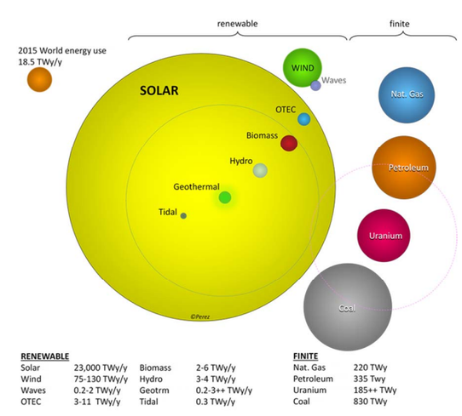
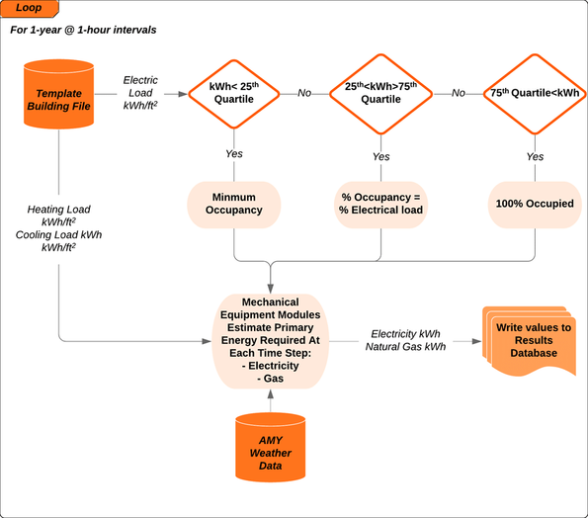
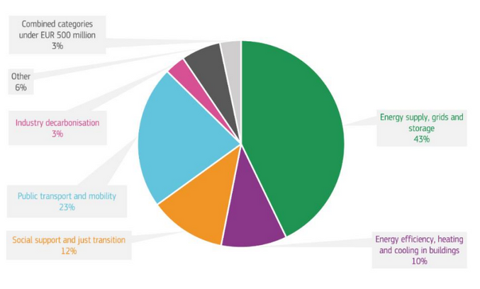
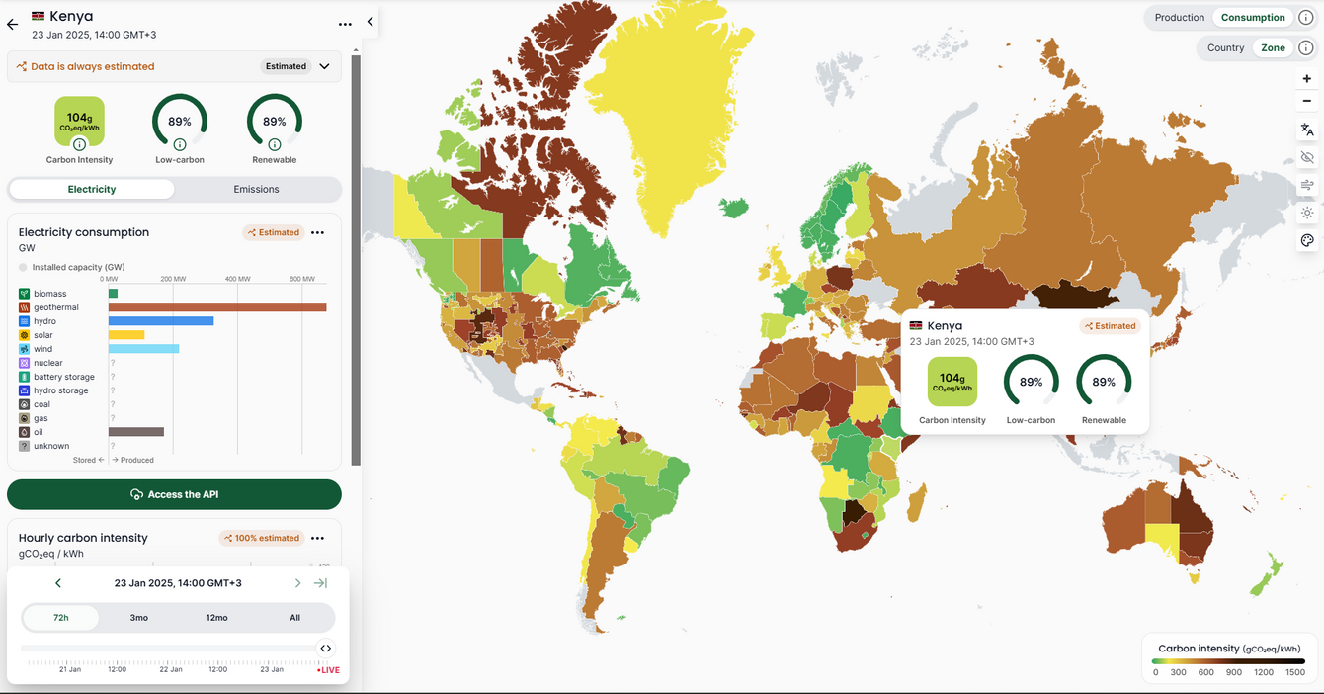
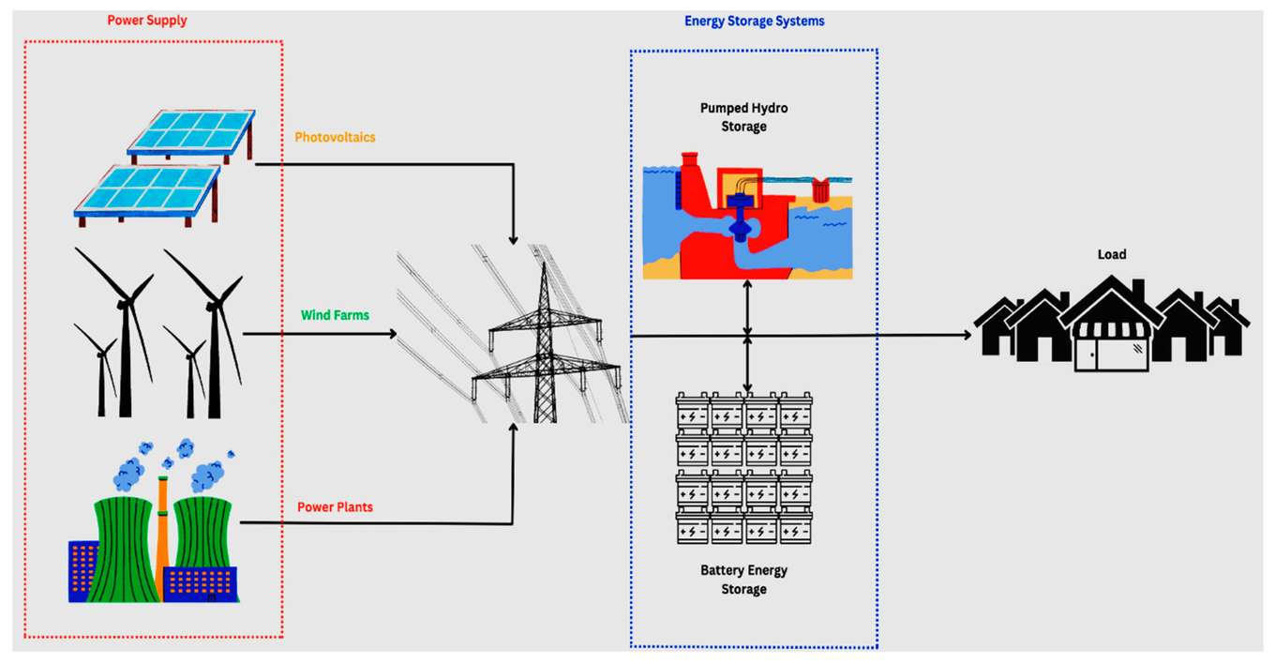
https://climate.ec.europa.eu/document/download/d0671350-37f2-4bc4-88e8-088d0508fb03_en
https://digitalcommons.pace.edu/cgi/viewcontent.cgi?article=1006&context=environmental
DOI:10.1016/j.enbuild.2020.110279
https://www.mdpi.com/1996-1073/16/3/1415
21
https://app.electricitymaps.com/zone/KE/72h/hourly/2025-01-23T11:00:00.000Z#bar_breakdown_chart

Slide 22











Thank You for Joining!
22

